Slide 1
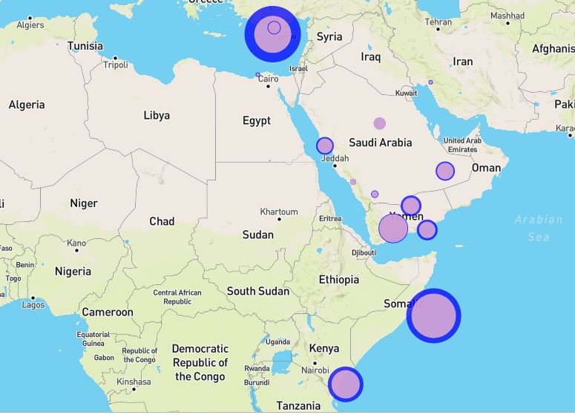
Gender Pay-Gap Report
By:
Nitha B
Natalie S
Loba Q

Slide 2

Contents
Global Gender Gap
Overall Gender Gap in U.S.A
Gender Gap by Race
Gender Gap by Occupation
Gender Gap Education
This Photo by Unknown Author is licensed under CC BY

Slide 3
Understanding the gender gap
A gender gap in earnings has proven both persistent and universal.
This project relies mainly on U.S. data, but a gap between women’s and men’s earnings exists in every country.
Equal pay for equal work is the concept of labour rights that individuals in the same workplace be given equal pay. ... Since President John F. Kennedy signed the Equal Pay Act of 1963, it has been illegal in the United States to pay men and women working in the same place different salaries for similar work.
Our project explores the statistics of a few of the main areas ways where women are constantly falling behind their male counterparts.

Slide 4
Resources:
Data retrieval
International Labour Organization: The International Labour Organization (ILO) was founded in 1919 to promote social justice and thereby contribute to universal and lasting peace.
Department of Labor: Bureau of Labor is the principal federal agency responsible for measuring labor market activity, working conditions, and price changes in the economy.

Slide 5
Coding Approach
Data cleaning in Jupiter notebook
“Create Engine” to connect to Postgres database
Data upload into SQL database
Python connection to SQL database
Using flask map routes
Flask app retrieving data from database and
GeoJSON
Integrating JS with Flask to plot our visualization dashboard

Slide 6
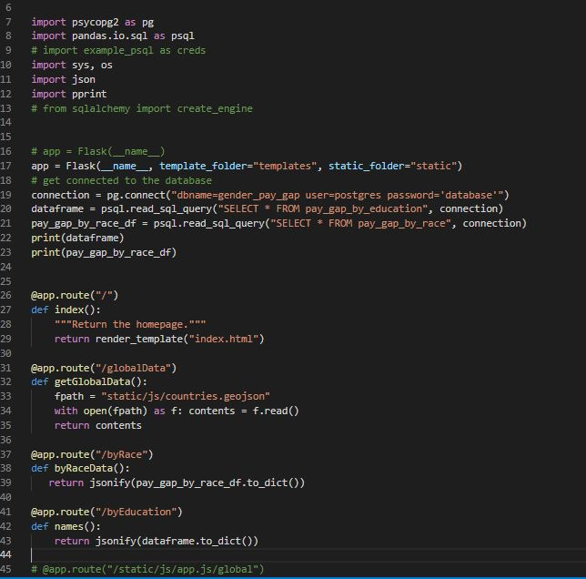
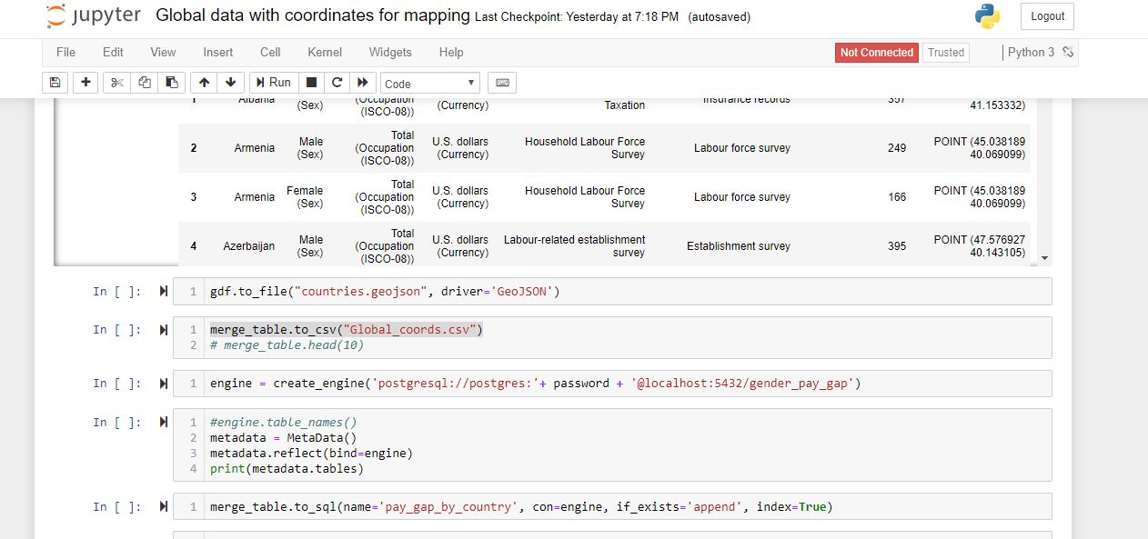
Coding snippets…
Jupyter Notebook:
Flask App:

Slide 7
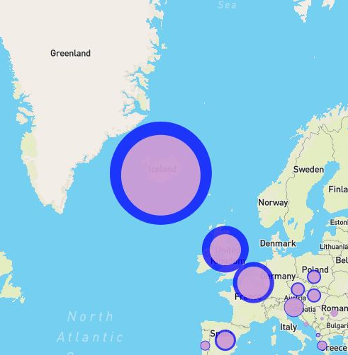
Global differences
We took 2016 data from 45 countries around the world and looked at the annual earnings of each gender and compared the differences.
Our data provided us with US currency comparisons
In high-income countries, such as Western Europe for example, almost all of the gender pay gap remains unexplained.
So what could then be the factors that lie behind gender pay gaps?

Slide 8
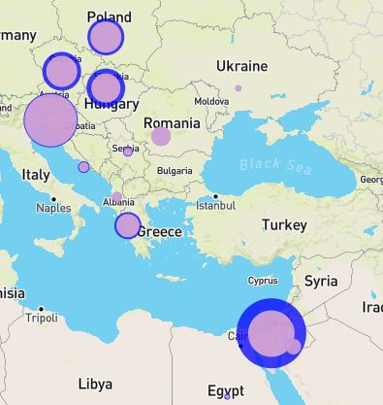
Global differences CONT..
Research shows that in Europe, for example, working in an enterprise with a predominantly female workforce can bring about a 14.7 per cent wage penalty compared to working in an enterprise with similar productivity attributes but a different gender mix.
This 14.7 per cent gap can translate into a loss of about €3,500 (approximately US$4,000) in salary per year for those who work in feminized sectors.

Slide 9
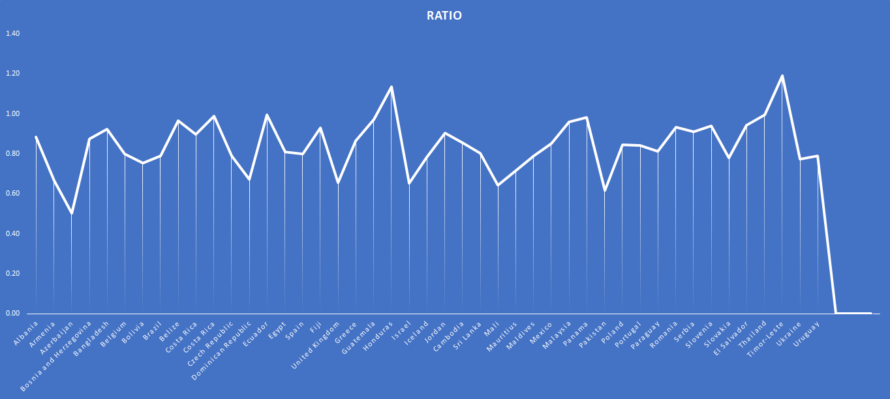
From the 45 countries, only 3 of them or 7% has equal pay ratio
By pay ratio we mean that for every 1 cent earned for men, women earn 1 cent or more
Azerbaijan, women get paid half of men get paid
While East Timor women gets $1.19 per men’s $1

Slide 10
The Bureau of Labor Statistics reported that, in 2013, female full-time workers had median weekly earnings of $789, compared to men's median weekly earnings of $973.
USA STATISTICS

Slide 11
By race The Gender Wage Ratio for Full-Time Workers
Our findings indicate that Asian men & women earn the most – average for men $1241 per week
But for every $1 that men earn, women earn $0.76
Caucasians – average for men $1002 per week
But for every $1 that men earn, women earn $0.82
Black/African men earn $735 per week
But for every $1 that men earn, women earn $0.89
Latin earnings $720 per week
But for every $1 that men earn, women earn $0.85

Slide 12

By education
Overall women EARN $0.80 for every $1
For PHD, women earn only $0.75

Slide 13

BY EDUCATION
Surprising discovery, as women earned higher education their pay gap increased from their male counterparts, who had the same education

Slide 14
By Occupation
Our assumptions vs Results:
Assumptions:
Results:
Management positions earn the most money, so as the salary gets higher the pay gap between the genders decrease.
For every$1that men earn in higher management positions, women earn $0.80
Sales & office occupations workers.. the pay gap decreases
Then the number grows for service occupation
But that’s only cause the $ amount is lower so the incremental is lower
For every $1 for men women earn $0.73

Slide 15
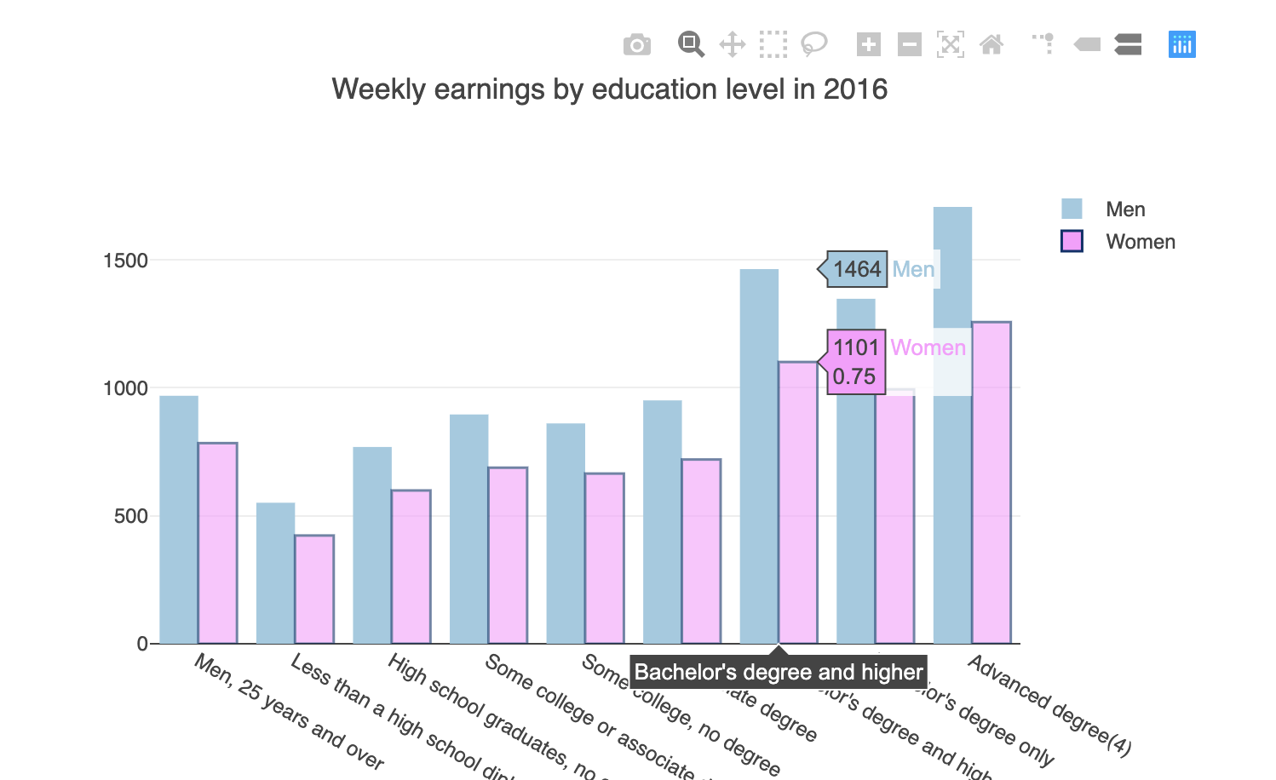
New libraries
dataframe-js
In Javascript, a data frame can be made in a number of different ways. For instance, consider a weather report that records, the high and low temperature for a city, the prevailing conditions, and the wind (speed and direction). A dataframe can take a column oriented approach, where the columns are specified and the values are given in row order.
Needed to convert df pandas to jsdf
We used it for filtering year columns for our charts

Slide 16
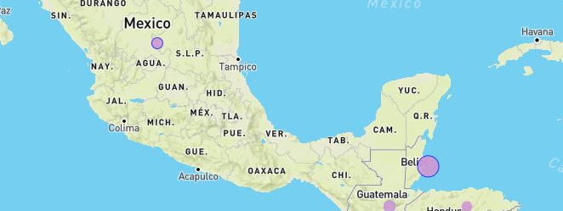
geopandas
We added Geo pandas to create our json files into Geojson to help load our map into python and work with leaflet.

Slide 17
Our Learning process
Biggest hurdles:
How to integrate flask with geojson
Dataframes into Javascript
Postgres SQL with Python
Deepened our knowledge of the D3 library
Leaflet with Python
Merging our Javascript app leaflet with python flask
Github communication

Slide 18
conclusion
First thoughts …Countries that are mainly male dominated would be discriminatory towards women so would have huge gaps in their pay
Surprised to find, society such as
UK have higher gaps with a 20% difference
While a place such as Egypt was 27% difference
Meanwhile Ecuador was only 10%
Originally we thought the higher the education… the better the salary so the gap would decrease but it increases
Caucasians being the highest population their paygrade is only the 2nd highest
Considering it is illegal to pay women less and all the social awareness of inequality, there is such a huge gap in pay and why it persists definitely needs to be further explored

Slide 19

Our takeaway
What we need to improve on:
Using Github for project work
Merging and pulling, and not deleting data
Differences between app server and local server
Filepaths: how to create file path in order to have fully functional full stacks
Handle all the work of databases, servers, systems engineering, and clients.
This Photo by Unknown Author is licensed under CC BY-SA-NC

Slide 20
Works cited
https://ilostat.ilo.org/
https://www.bls.gov/data/
https://iwpr.org/publications/gender-wage-gap-2018/
https://iwpr.org/publications/gender-wage-gap-2018/

